Slide 1
Fraud, waste, and abuse of public funds for the local audience
Institution Affiliation
Students’ Name
Date of Presentation

Slide 2
Fraud, waste, and abuse of public funds for the local audience
In every year, the value of public resources gets lost in most of the organizations just because of fraud, waste, and abuse of public funds.
In an environment of resource control, which is common in most of the organizational departments, it is essential to ensure that public resources, as well as funds, are responsibly managed.
There are many ways in which fraud can occur in the department or organization. They include; making of payments, when collecting public funds, and when assigning contracts to the people.
Waste of public funds entails allocating public funds and other resources in excess.
Notes:
In every year, the value of public resources gets lost in most of the organizations just because of fraud, waste, and abuse of public funds. In an environment of resource control, which is common in most of the organizational departments, it is essential to ensure that public resources, as well as funds, are responsibly managed. There are many ways in which fraud can occur in the department or organization. They include; making of payments, when collecting public funds, and when assigning contracts to the people. Waste of public funds entails allocating public funds and other resources in excess. For instance, reckless requisition of more funds than actual that is required is a good reflection of the waste of public funds. However, wastage of public funds does not only mean an aspect of personal gain, but also it indicates poor management of public resources and funds. Lastly is on abuse of public funds.

Slide 3
Cont.…
Abuse can be termed as a subset of waste, and it involves the exploitation of the loopholes above the organizational law for personal gain.
This presentation illustrates various ways, including positive incentives, detection, investigations, and appropriate sanctions to help the department reduce the risks of fraud, waste, and abuse of public funds.
While reflecting on the diversity and the features of this organization department, some approaches are more appropriate to combat public funds.
Therefore, it is the responsibility of respective managers in public sectors to identify and implement the most effective and efficient ways of fighting fraud, wastage, and abuse of public funds through appropriate countermeasures.
Notes:
Abuse can be termed as a subset of waste, and it involves the exploitation of the loopholes above the organizational law for personal gain. For example, one may take advantage of the allowances he/she is given by the organization and makes unnecessary decisions to create fake transparency and accountability to claim more benefits over it. A good example is a travel allowance whereby an individual may use that opportunity to request for the luxurious vehicle when on duty and sell it for a substantial profit upon completion of the assignment. This presentation illustrates various ways, including positive incentives, detection, investigations, and appropriate sanctions to help the department reduce the risks of fraud, waste, and abuse of public funds. While reflecting on the diversity and the features of this organization department, some approaches are more appropriate to combat public funds. It is the responsibility of respective managers in public sectors to identify and implement the most effective and efficient ways of fighting fraud, wastage, and abuse of public funds through appropriate countermeasures.

Slide 4
Cont....
To support the new forensic plan to check fraud, waste, and abuse of public in my department, there are primary stages at which the measures to control fraud and waste of public funds can be implemented. These are; prevention, detection, investigation, and sanctioning.
The primary support against fraud, waste, and abuse of public funds in my department is to set prevention techniques.
In this case, appropriate systems and policies will be put in place to minimize motivation and opportunities to engage in fraud and abuse of public funds.
The department will try to offer positive incentives in the form of material or symbolic rewards for efficiency and effectiveness in the procurement and management of resources.
Notes:
To support the new forensic plan to check fraud, waste, and abuse of public in my department, there are primary stages at which the measures to control fraud and waste of public funds can be implemented. These are; prevention, detection, investigation, and sanctioning.
The primary support against fraud, waste, and abuse of public funds in my department is to set prevention techniques. In this case, appropriate systems and policies will be put in place to minimize motivation and opportunities to engage in fraud and abuse of public funds. For example, identifying areas which are vulnerable to fraud, and provide the instruction on processes by which resources are acquired and managed. Alternatively, the department will try to offer positive incentives in the form of material or symbolic rewards for efficiency and effectiveness in the procurement and management of resources.

Slide 5
Cont.…
Additionally, I will use an effective system for the detection of fraud in the department.
Also, regular use of internal auditing reinforced by harsh external audits will be part of my prevention measures.
Lastly, there should be a formal procedure for reporting fraud, waste, and abuse of public funds cases in my department among employees.
Creating Public awareness
Creating public awareness against fraud, waste, and abuse of public funds is one of the measures to be used. This awareness will be reinforced by word and by the deed from the top management moving downwards to other employees.
The campaign strategies will include; rational or empirical appeals based on the principle that fraud, waste, and abuse of funds control is in the best interest of all personnel in my department.
Notes:
Additionally, I will use an effective system for the detection of fraud in the department. Also, regular use of internal auditing reinforced by harsh external audits will be part of my prevention measures. Lastly, there should be a formal procedure for reporting fraud, waste, and abuse of public funds cases in my department among employees. Creating public awareness against fraud, waste, and abuse of public funds is one of the measures to be used. Although it is not regarded as the exact solution to reduce the challenges of public expenditure, it is one of the complements of the countermeasures. This awareness will be reinforced by word and by the deed from the top management moving downwards to other employees. The campaign strategies will include; rational or empirical appeals based on the principle that fraud, waste, and abuse of funds control is in the best interest of all personnel in my department.

Slide 6
Cont.…
There will be coercive approaches involving formal authority to force the acceptance of change in the department.
The department will put strict policies for the control of fraud, waste, and abuse of funds that will be communicated throughout the departments and to individuals and other organizations either in the private/public sector, which will be engaged in doing business in the organization through my department.
Actions in the department will reinforce any fraud awareness initiative.
Managers, employees, and other respective agencies must demonstrate their commitment to fraud and abuse of public funds control by deed as well as by word. Policies should be consistently and visibly applied.
Notes:
There will be coercive approaches involving formal authority to force the acceptance of change in the department. Lastly, there will be normative and re-educative methodologies that will involve widespread participation in setting goals and in monitoring achievement in the department. Campaign awareness against fraud, waste, and abuse of public funds will be an integral part of training employees in my department.
The department will put strict policies for the control of fraud, waste, and abuse of funds that will be communicated throughout the departments and to individuals and other organizations either in the private/public sector, which will be engaged in doing business in the organization through my department. Actions in the department will reinforce any fraud awareness initiative. Managers, employees, and other respective agencies must demonstrate their commitment to fraud and abuse of public funds control by deed as well as by word. Policies should be consistently and visibly applied.

Slide 7
Value engineering
This is also one of the techniques to reduce fraud and misuse of public funds, which I support.
There will be an analysis that will be performed by an independent team, whose members' qualifications depend upon the nature of the project or product under scrutiny.
This technique of value engineering will save the wastage of public funds from 5 to 10 percent of total project costs.
Throughout a large scale project, such savings can amount to more than a tenfold return from an original investment in value engineering services.
Notes:
The recent forensic plan addressed the issue of value engineering. This is also one of the techniques to reduce fraud and misuse of public funds, which I support. It is another way of controlling the cost of the public project where it uses the systematic scrutiny of a project in its design stage for alternative project components, materials, or methods that would perform the intended functions at less cost. There will be an analysis that will be performed by an independent team, whose members' qualifications depend upon the nature of the project or product under scrutiny. Ideally suited to large scale construction projects or the procurement of major capital equipment. This technique of value engineering will save the wastage of public funds from 5 to 10 percent of total project costs. Throughout a large scale project, such savings can amount to more than a tenfold return from an original investment in value engineering services.

Slide 8
Management of information system
Efficient management of organizational resources requires some means of monitoring resource acquisition, inventory, and use.
At each level within the department, managers will be able to make a comparison of the patterns of resource acquisition and use by subordinate units.
The very existence of such oversight is likely to induce managers of those auxiliary units to manage their resources more carefully.
Observed anomalies will provide senior managers with early warning indicators of fraud or waste of funds.
Notes:
Another critical element to be considered to reduce the challenges of waste and misuse of public funds is the control of the information system. In this case, efficient management of organizational resources requires some means of monitoring resource acquisition, inventory, and use. Though this might appear evident to the point of ordinariness, and it may seem like the existing management information systems in an organizational department may not permit the degree of internal oversight necessary for the effective control of fraud, waste, and abuse of funds. At each level within the department, managers will be able to make a comparison of the patterns of resource acquisition and use by subordinate units. The very existence of such oversight is likely to induce managers of those auxiliary units to manage their resources more carefully. Observed anomalies will provide senior managers with early warning indicators of fraud or waste of funds.

Slide 9
Public Vigilance: Visibility and accountability of transactions
The more visible the transaction, the less vulnerable it is to fraud, waste, and abuse.
There will be proper regulations that will require the gazettal of all things that the department will purchases.
Beyond this, aggressive investigative journalists and citizen watchdog groups will have an important role to play in enhancing the visibility of public-sector activity.
Notes:
The principle that sunlight is the best disinfectant applies to much in public-sector activity. The more visible the transaction, the less vulnerable it is to fraud, waste, and abuse. While it can be argued that matters of individual privacy, trade secrecy and departmental security might militate against public access to many transactions involving public sector agencies, democratic principles imply that activity conducted on behalf of the public should be visible to that public. For example, regulations require the gazettal of all things that the department will purchases. Beyond this, aggressive investigative journalists and citizen watchdog groups will have an important role to play in enhancing the visibility of public-sector activity.

Slide 10
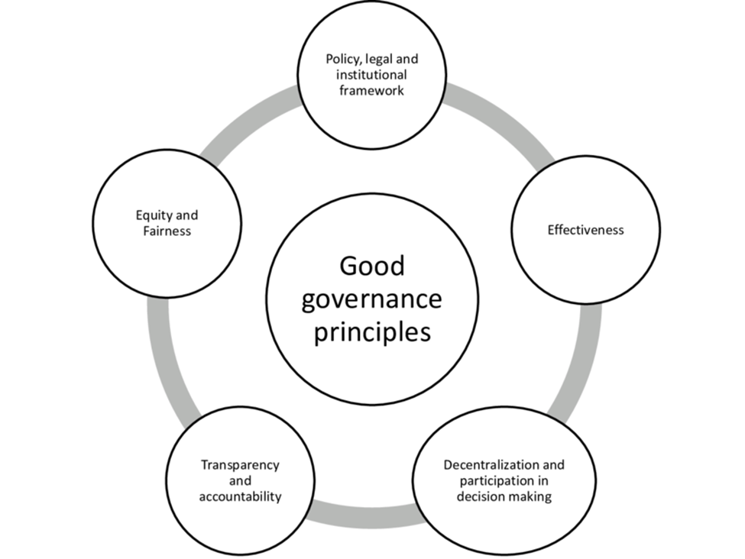
The diagram below shows how good governance can be used to reduce the challenges of fraud, waste and ause of pulic funds.
Notes:
The above diagram describes how good governance can also e used as a tool to curb fraud and abuse of public funds. It starts by appropriate establishing appropriate policies, legal and institutional framework that will be used by employees and other workers in the department to prevent and condemn abuse and fraud acts. Also, equity and fairness will also contribute towards reducing cases of fraud. Transparency and accountability as well as effectiveness are among the ways of reducing fraud, waste and abuse of public funds.

Slide 11
Whistleblowing and hotlines
It helps in creating a good room and for the relevant departmental authorities as well as respective managers to detect and investigate fraud, wastage, and abuse of public funds against the organization.
Given these capabilities, it seems appropriate that the energies of the general public and public servants generally be usefully enlisted to reduce fraud, waste, and abuse of public funds.
There will be an internal channel through which concerns will be articulated using the chain of command that is inappropriate in the more severe cases of fraud and waste of funds.
For this reason, the department will develop mechanisms for protecting legitimate whistleblowers. This would typically entail provisions for employment protection and legal assistance, where required.
Notes:
To investigate organizational resources and public funds, there are unlimited ways, and creating whistleblowers and hotlines is one of the methods. In this case, it helps in creating a good room and for the relevant departmental authorities as well as respective managers to detect and investigate fraud, wastage, and abuse of public funds against the organization. Given these limited capabilities, it seems appropriate that the energies of the general public and public servants generally be usefully enlisted to reduce fraud, waste, and abuse of public funds. Ideally, there should be an internal channel through which concerns will be articulated. Using the chain of command will be inappropriate in the more severe cases of fraud and waste of funds. For this reason, the department will develop mechanisms for protecting legitimate whistleblowers. This would typically entail provisions for employment protection and legal assistance, where required.

Slide 12
Cont..
The department will provide support to protect the witnesses in case they are true of protection.
The department will also ensure safeguard against frivolous or vexatious activity under the guise of whistleblowing.
Formal mechanisms for the identification and penalization of false complaints are integral to any proper whistleblower protection program in the department.
The use of hotlines will also be much effective as the plan to control fraud, waste, and abuse of funds. This is to receive confidential disclosure of irregularities through telephone, and it will be available on a 24-hour basis.
Notes:
In circumstances where the legitimate whistleblower sees him or herself as unable to continue within the organization, assistance with job placement may be appropriate. In extreme cases, the department will provide support to protect the witnesses in case they are true of protection. On the other hand, the department will also ensure safeguard against frivolous or vexatious activity under the guise of whistleblowing. Formal mechanisms for the identification and penalization of false complaints are integral to any proper whistleblower protection program in the department. Alternatively, the use of hotlines will also be much effective as the plan to control fraud, waste, and abuse of funds. This is to receive confidential disclosure of irregularities through telephone, and it will be available on a 24-hour basis, during regular business hours, or periodically, as is the case with operation NOAH, the department will be responsible for the disclosure program. Therefore, hotline complaints will be screened, and those with the apparent foundation will be selected for further investigation.

Slide 13
Auditing
The first line of defense against fraud, waste, and abuse of public funds, whether by public employees or by external contractors, is the audit.
In the department, I will help to reduce the risks of fraud, wastage, and abuse of funds by creating a robust internal audit that is transparent and visible.
Also, the department will introduce electronic trading that will entail particular fraud risks that require commensurate audit capabilities.
Concerning the accuracy of physical inventories and public funds of the organization, auditing activity will be carried out regularly.
Notes:
Good security practices are integral to proper management. The first line of defense against fraud, waste, and abuse of public funds, whether by public employees or by external contractors, is the audit. In the department, I will help to reduce the risks of fraud, wastage, and abuse of funds by creating a robust internal audit that is transparent and visible. As such, they will contribute to fraud prevention as well as detection (Independent Commission Against Corruption 1991, p.17). Also, the department will introduce electronic trading that will entail particular fraud risks that require commensurate audit capabilities. Concerning the accuracy of physical inventories and public funds of the organization, auditing activity will be carried out regularly. This is to evaluate the effectiveness of internal controls, surprise audits and inspections will be carried out as a matter of policy. Also, through creative management, the department will be able to allow random, unannounced audits to be made a fact of life, less likely to be regarded as intrusions or as violations of autonomy, and thus not detrimental to morale.

Slide 14
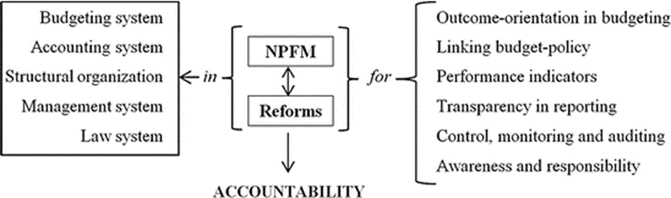
The diagram below shows a control circle of reducing the risk of fraud, waste and abuse of public funds.

Slide 15
References
Donohue, K. M. (2015). Combatting Fraud, Waste and Abuse: A More Proactive Approach is the Answer. The Journal of Government Financial Management, 64(1), 54.
Moore, J. (2010). Preventing and detecting fraud, waste, and abuse. Public Manager, 39(2), 72.
Curato, R. J., McCurrie, J. D., Plifka, K. F., & Relation, A. J. (1982). Government Fraud, Waste, and Abuse: A Practical Guide to Fighting Official Corruption. Notre Dame L. Rev., 58, 1027.
Miethe, T. (2019). Whistleblowing at work: Tough choices in exposing fraud, waste, and abuse on the job. Routledge.

